Slide 1
Pregnancy and Its Disorders
Chapter 59
2020. 6. 12.

Slide 2
Table of Contents
Human Pregnancy
Placenta, amniotic fluid
Maternal adaption, functional development of fetus
Maternal & Fetal Health Assessment
Complications of Pregnancy
Prenatal Screening for Fetal Defects
Terminology and methods
Prenatal screening tests
Epidemiologic monitoring
Laboratory Tests
hCG, AFP, uE3, Inhibin A, PAPP-A, fFN, PAMG-1, FLM

Slide 3
Human Pregnancy
To understand role of Lab., in pregnancy care, need to know:
Process of pregnancy
Embryo development
Fetal growth
Role of placenta
Amniotic fluid
Maternal adaptations
Functional maturation of fetus

Slide 4
Placenta - overview
Primary link between fetus and mother
Functions
Separation of circulation
Supply nutrients
Eliminate wastes
Produces hormones

Slide 5
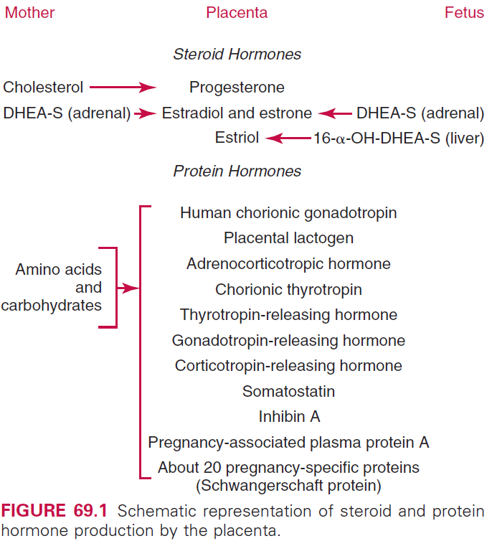
Placenta - hormones
Major hormones of placenta
hCG (human chorionic gonadotropin)
hPL (human placental lactogen)
Hormone production
Increase in proportion to placental mass
Also increase in maternal serum
Except hCG, peak in 1st trimester
?

Slide 6
Placenta - hormones
hCG
Maintaining the corpus luteum → prevents menstruation
hPL
Preparing the mammary glands for breast milk
Placental steroids (Estrogen, progesterone, …)
Endometrium development, uterine growth & blood supply
Preparation of uterus for labor

Slide 7
Amniotic Fluid - overview
Volume and chemical composition: narrow range
Functions
Cushions a fetus
Maintain a temperature
Swallowed by the fetus

Slide 8
Amniotic Fluid – volume and dynamics
Volume
Increased until 34th week
Decrease until 40th week
Rapid decrease after 40th week
Clinical increase and decrease due to…
Oligohydroamnios: both renal agenesis, obstruction of urethra
Hydroamnios
Maternal DM, severe Rh isoimmune, multifetal pregnancy
Fetal esophageal atresia, anencephaly, spina bifida

Slide 9
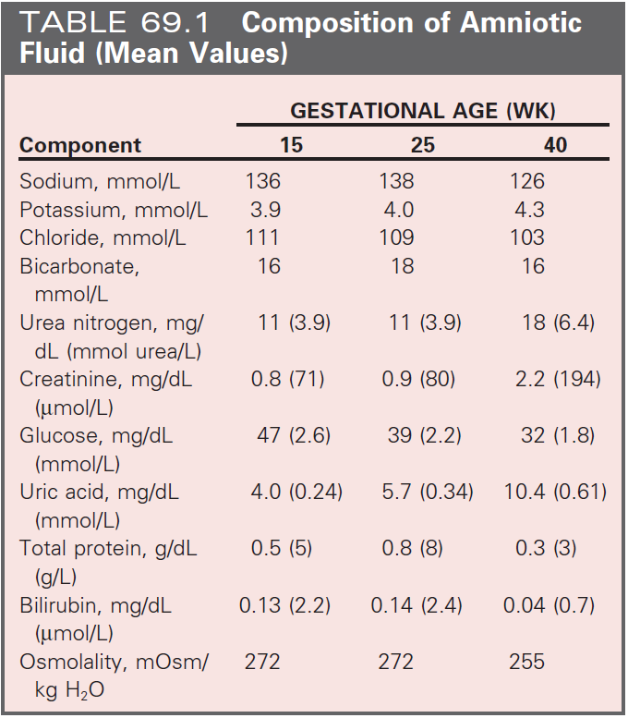
Amniotic Fluid – composition
1st trimester: resembles dialysate of the maternal serum
Composition changes during pregnancy
Phospholipids
Reflects fetal lung maturity
16th week, many cells are present
Amnion, skin, bronchial tree

Slide 10
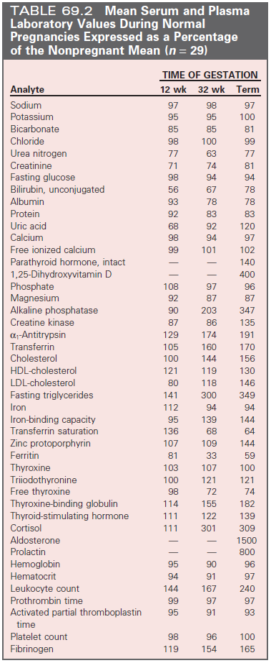
Maternal Adaptation
Metabolic, physiologic, endocrinologic affects by
Large quantities of estrogen
Progesterone
Placenta lactogen
Corticoid steroids
References ranges are not applicable d/t
↑Resistance to angiotensin
↑Lipid metabolism vs. glucose
↑Thyroid and steroids binding protein

Slide 11
Functional Development of the Fetus
Fetal organs
Mature during 3rd trimester
Various rates
Lung
Liver
Kidneys
Blood maturation

Slide 12
Maternal & Fetal Health Assessment
Optimum: consult before conception
Medical & family history
Physical examination
Laboratory tests
Lab. tests
Hct, ABO/Rh, RBC antibody screening
Papanicolaou smear, U/A
Rubellar titer, RPR, gonococcal, chlamydia, HIV, HBV
Cystic fibrosis carrier

Slide 13
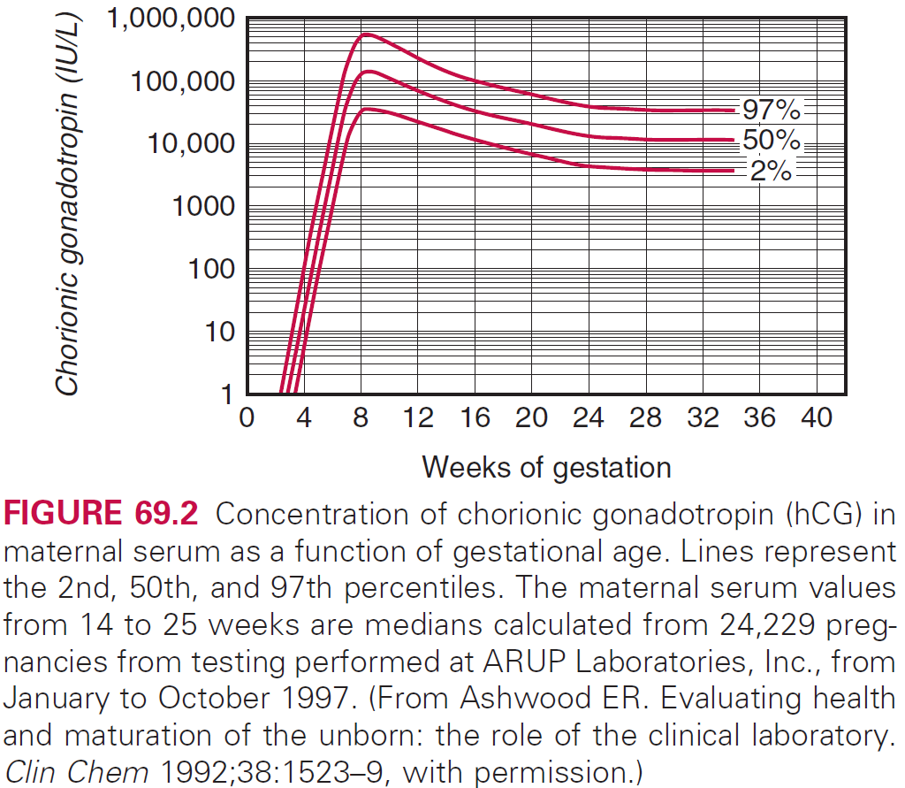
Maternal & Fetal Health Assessment
All pregnancy should receive
NTD (neural tube defects)
Aneuploidy tests
Diagnosis and Dating of Pregnancy
hCG: most useful
Accurate gestational age : most important

Slide 14
Complications of Pregnancy
Can primarily occur in the Mother
Ectopic pregnancy
Hyperemesis gravidarum
Preeclampsia
HELLP syndrome
Liver disease
Hemolytic disease of the new born
Must distinguish these conditions from normal physiologic changes

Slide 15
Complications of Pregnancy
시간 남으면 추가 p.1670 P.T.R.

Slide 16
Screening for Fetal Defects
The process of identifying high risks of a serious birth defects
Neural tube disease, Down syndrome, …
cffDNA (cell free fetal DNA) in maternal blood
Non-invasive
Fetal aneuploidies
Not for NTD
Not for multiple gestations

Slide 17
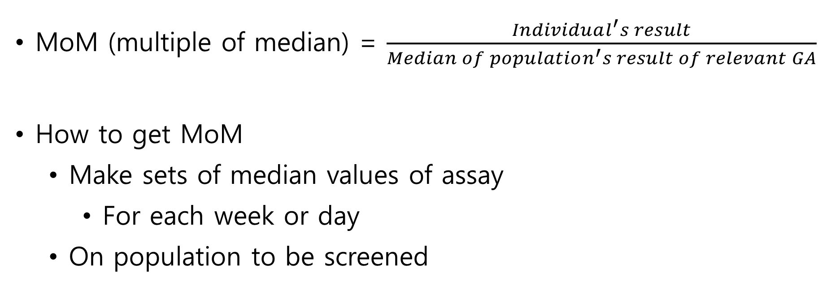
Terminology and Risk Calculation
MoM (multiple of median) = $\frac{Individual^{′}s result}{Median of population^{′}s result of relevant GA}$
How to get MoM
Make sets of median values of assay
For each week or day
On population to be screened

Slide 18
Calculating Individualized Patient-Specific Risks Using Multiple Biochemical measurements
Measured value → MoM for GA → adjust for weight, race.. = Adjusted MoM
Likelihood ratio = (see next slide)
Patient-specific risk = priori-risk x likelihood ratio
This equation is used for: NTD, T21, T18

Slide 19
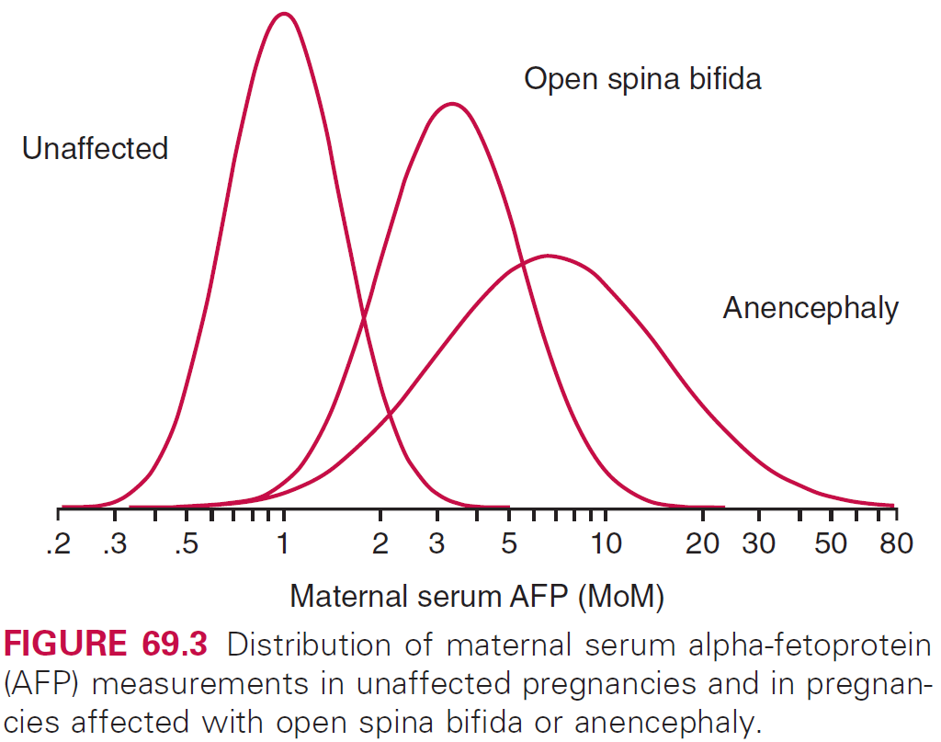
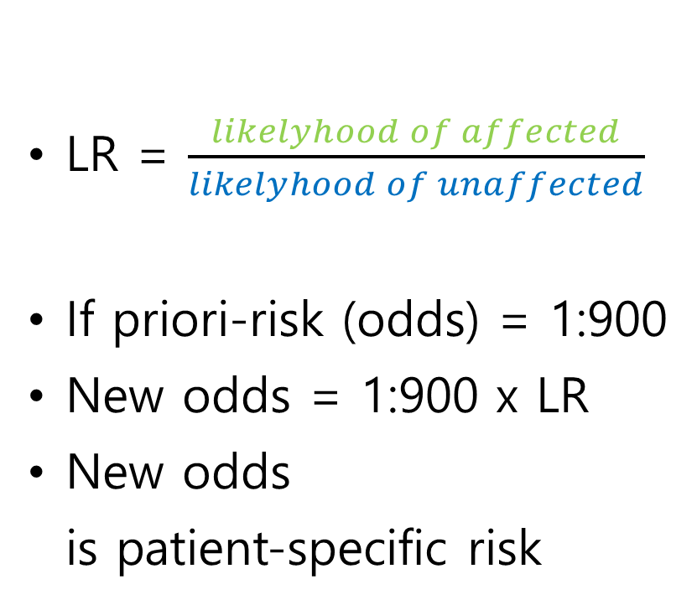
Calculating Individualized Patient-Specific Risks Using Multiple Biochemical measurements
LR = $\frac{likelyhood of affected}{likelyhood of unaffected}$
If priori-risk (odds) = 1:900
New odds = 1:900 x LR
New odds is patient-specific risk
Unaffected
Relative probability
0.6
0.24

Slide 20
Calculating Individualized Patient-Specific Risks Using Multiple Biochemical measurements
Calculated patient-specific risk
Reported as a ratio
Needs interpretation

Slide 21
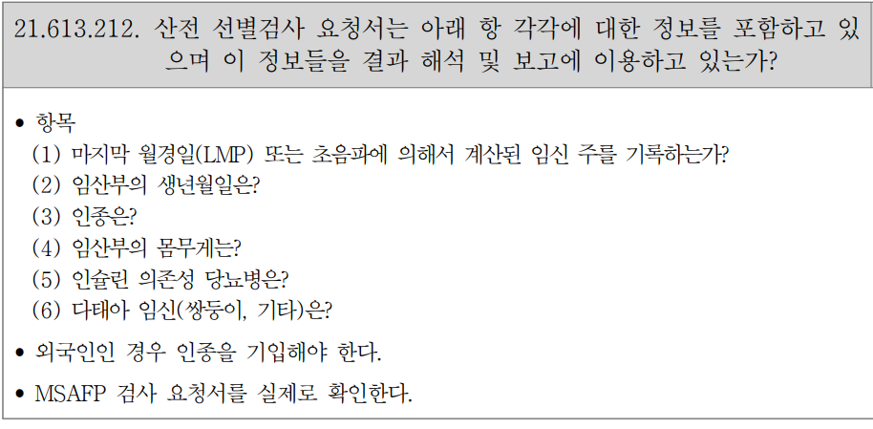
Reporting Individual Results
Should contain
Concentration & MoM
Interpretation: pos. or neg.
Risks estimated
Further recommendations
Physician should give
Date of sample collection, 1st or 2nd trimester, gestational age,
Related pregnancy history, # of fetus, maternal race
IDDM before pregnancy
대한진단검사의학회/진단검사의학재단(Jan, 2020). 우수검사실 신임인증 심사점검표 임상화학. 대한진단검사의학회/진단검사의학재단.
Notes:
대한진단검사의학회/진단검사의학재단(Jan, 2020). 우수검사실 신임인증 심사점검표 임상화학. 대한진단검사의학회/진단검사의학재단.

Slide 22
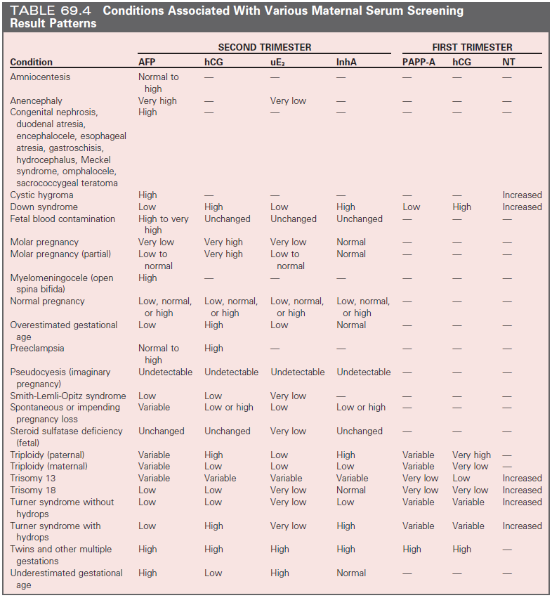
Prenatal Screening Tests

Slide 23
NTD - overview
High AFP (alpha-fetoprotein)
Occurs in early embryo development
Causes of brain or spinal cord defects
Anencephaly
Meningomyelocele (spina bifida)
Encephalocele
90% d/t problem of multifactorial inheritance
Or d/t folate deficiency

Slide 24
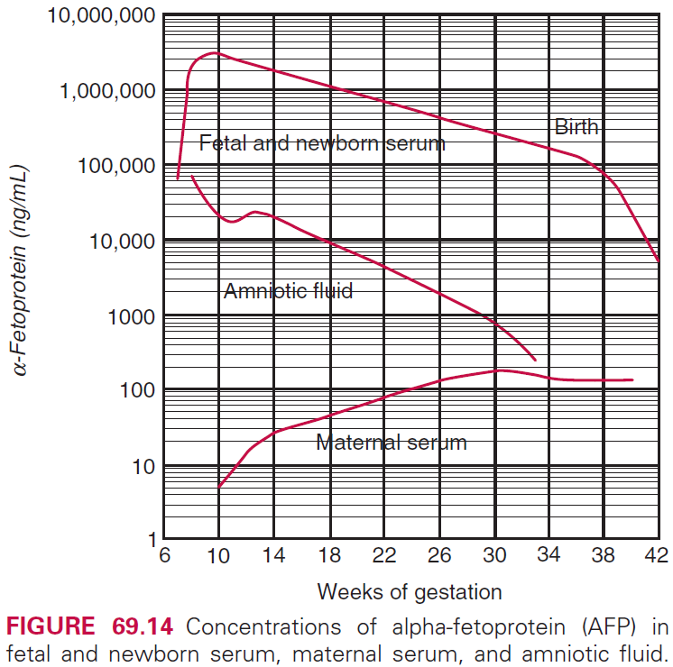
NTD – prenatal screening
Over 90% of NTD occurs with unsuspecting parents
Screening needs to be provided to all
Nowadays first line methods: imaging
Optimum timing: 16th~18th week
Maximal difference between affected and unaffected
Sufficient time for follow-up tests
Cut off(IPR): 2.0 MoM(3~5%), 2.5 MoM(1~3%)

Slide 25
NTD – follow-up testing
When positive result: genetic consultation
High resolution US: establish GA, multiple fetus, fetal death
Amniocentesis: AFP, AChE
Amniotic AFP
False positive with fetal blood contamination
AFP with AChE is actually diagnostic
High res. US
Almost always confirms chemical diagnosis

Slide 26
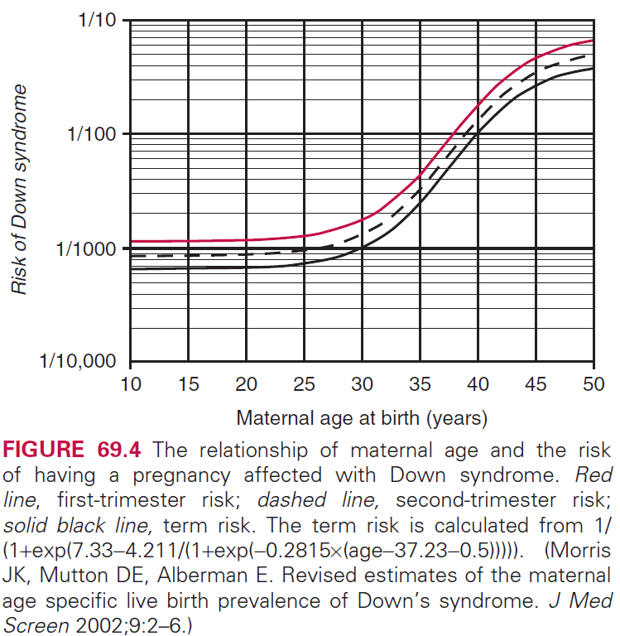
Down syndrome - overview
1:700 prevalence
Extra copy of 21q22.1~22.3
Almost trisomy 21, 5% translocation, 1% mosaic
Phenotype
Mental retardation
Hypotonia
Congenital heart defects
Characteristic face

Slide 27
Down syndrome – prenatal screening
AFP is low
Relationship between AFP and T21 is independent of maternal age
uE3 (unconjugated estriol) is low
hCG is twice as high
Inhibin A is high
In 1988, triple test was introduced.
In late 1990s, inhibin A was introduced.

Slide 28
Down syndrome – follow-up testing
When positive result: genetic consultation
Low resolution US: establish gestational age
Karyotyping: the only diagnostic
Karyotyping
Amniocentesis
Risk of fetal loss

Slide 29
Edwards syndrome - overview
Nondisjunction during meiosis: trisomy 18
25% in affected: comorbidity of spina bifida or omphalocele

Slide 30
Edwards syndrome – prenatal screening
AFP, uE3, hCG is low
Median of MoM
AFP = 0.65 MoM
uE3 = 0.43 MoM
hCG = 0.36 MoM

Slide 31
Edwards syndrome – follow-up testing
When positive result: genetic consultation
Sonography: not recommended
Aminocentesis or CVS

Slide 32
Smith-Lemil-Optiz syndrome – overview
Due to defect of cholesterol synthesis
Autosomal recessive
1:100,000 prevalence
Autism
Self-injury
Hyperactive
Cleft lip
Microcephaly

Slide 33
Smith-Lemil-Optiz syndrome – prenatal screening
AFP, hCG is low
AFP: 0.72 MoM
hCG: 0.76 MoM
uE3 is very low
0.21 MoM

Slide 34
Smith-Lemil-Optiz syndrome – follow-up testing
When positive result: genetic consultation
Amniocentesis
Amniocentesis
Elevated 7-dehydrocholesterol is diagnostic

Slide 35
Newer Screening Algorithms – 1st trimester combined
T21
PAPP-A (pregnancy-associated plasma protein-A): low, 0.4-0.5 MoM
hCG: high, 1.7-2.2 MoM
Nuchal translucency: high, 2.0 MoM
60% detection rate, 5% false-positive
T18
NT: high, 3.2 MoM
PAPP-A: low, 0.18 MoM
hCG: low, 0.28 MoM

Slide 36
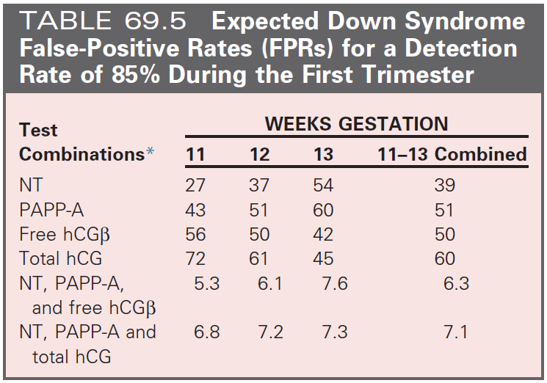
Newer Screening Algorithms – 1st trimester combined
Limitations
Not enough power with serum/US alone
Detection and false-positive rate is vary with GA
NT is relatively expensive and not provided in many regions
2nd trimester test is still needed (AFP)

Slide 37
Newer Screening Algorithms – integrated
Avoid almost limitation of 1st trimester combined test
NT & PAPP-A is measured in 1st trimester but interpret in 2nd
In 2nd trimester,
Do quadruple test
All six tests combined into single risk estimate
Low false-positive rate, less amniocentesis, less fetal loss / Dx.
Sequential integrated test vs. Contingent screening
Highest risk of T21 (≥1:25) undergo further w/u
Others undergo 2nd trimester screening
Notes:
Contingent screening 자리가 없어서 여기에 조금..
1삼분기 선별검사에서 양 끝단에 걸친 환자들은 결과를 통보받고 further eval.을 진행하며 나머지는 2삼분기 선별검사를 진행한다.

Slide 38
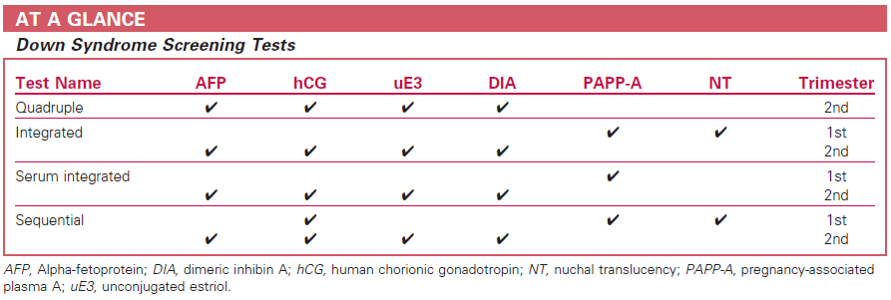
Newer Screening Algorithms

Slide 39
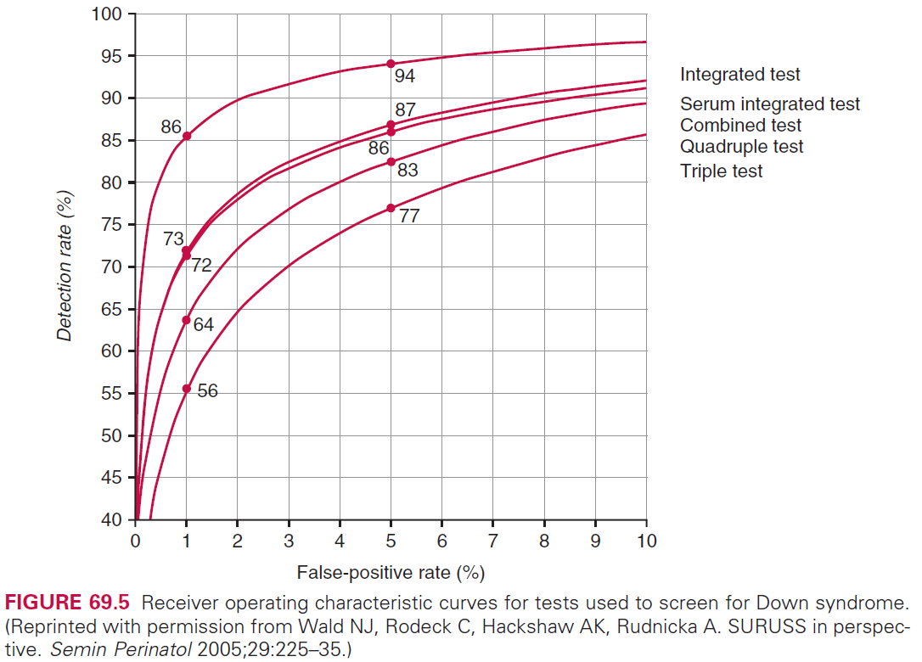
Newer Screening Algorithms

Slide 40
Adjustments for Factors
Screening test are optimal when
Compared with similar other woman in many aspects
Many aspects include
Gestational age
Maternal weight
Race
IDDM (insulin-dependent DM)
Multiple pregnancy

Slide 41
Adjustments for Factors
Screening test are optimal when
Compared with similar other woman in many aspects
Many aspects include
Gestational age
Maternal weight
Race
IDDM (insulin-dependent DM)
Multiple pregnancy

Slide 42
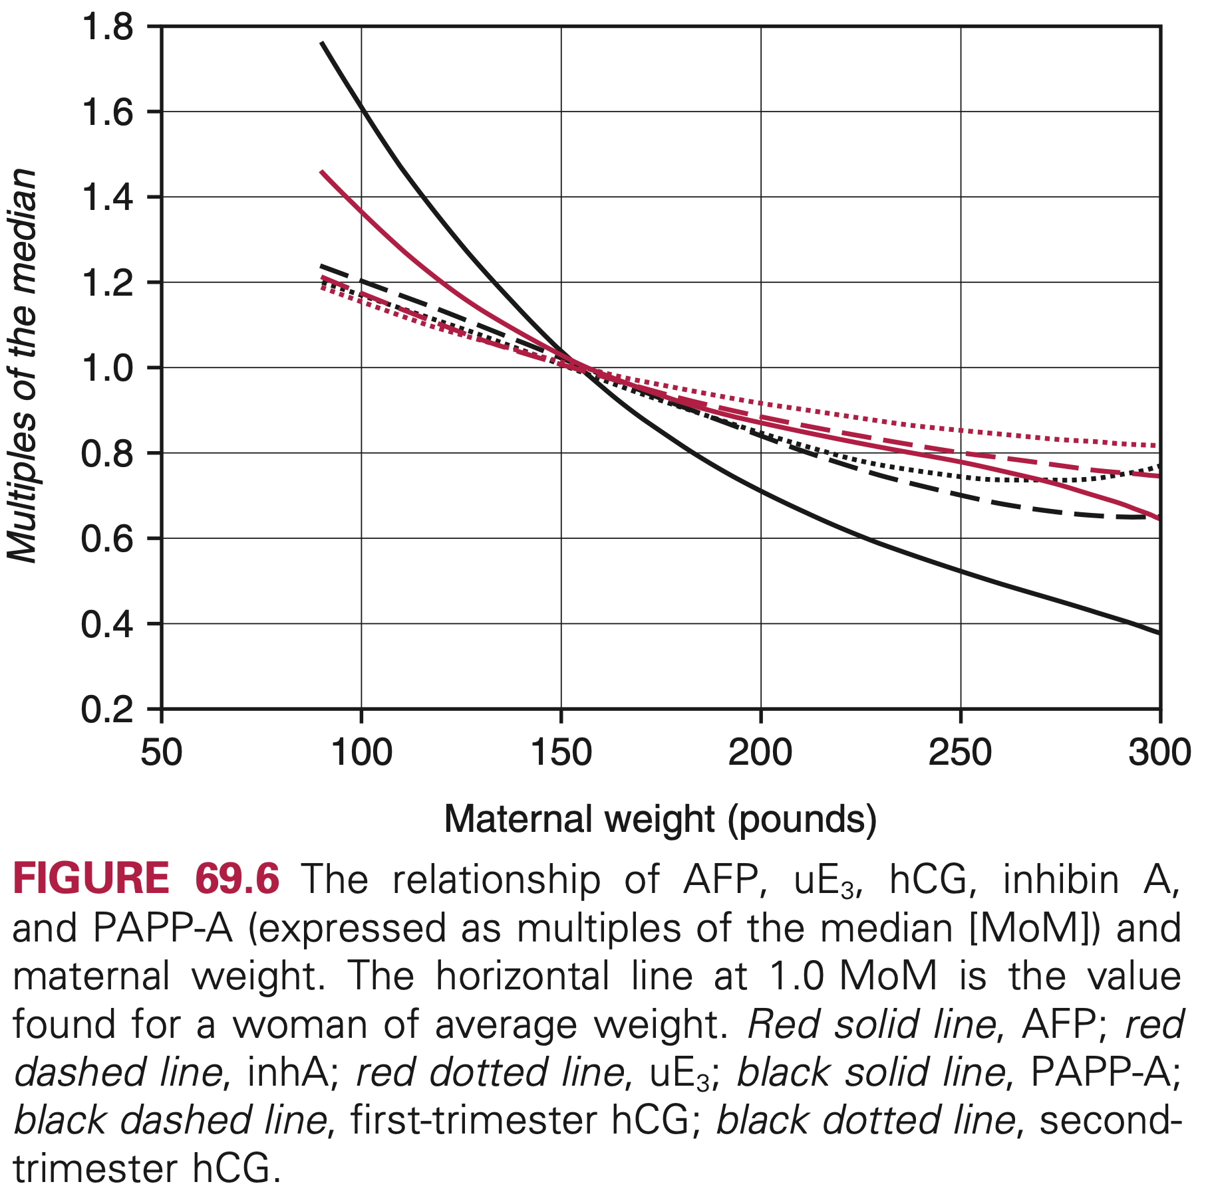
Adjustments – Maternal Weight
Increase of maternal weight
Concentration of analyte values is decreased
Because dilution with increased maternal blood volume
Weight effects are
Significant for AFP, hCG, inhibin A, PAPP-A
Less for uE3.

Slide 43
Adjustments – Maternal Race
African-American vs. Caucasian
10~15% higher AFP, hCG
Similar uE3
Asians (O’Brien JE, et al)
Higher AFP than Caucasian
Higher hCG, uE3 than Caucasian, Black
Notes:
O'Brien, J. E., Dvorin, E., Drugan, A., Johnson, M. P., Yaron, Y., & Evans, M. I. (1997). Race-ethnicity-specific variation in multiple-marker biochemical screening: alpha-fetoprotein, hCG, and estriol. Obstetrics and gynecology, 89(3), 355–358. https://doi.org/10.1016/S0029-7844(96)00524-8

Slide 44
Adjustments – Maternal Race
How to adjust?
Method A
Calculate MoM using the known other ethnical median
Divide calculated MoM by a factor between two populations
Method B
Calculate separate sets of medians using raw data

Slide 45
Adjustments – Maternal Race
How to adjust?
Method A
Calculate MoM using the known other ethnical median
Divide calculated MoM by a factor between two populations
Method B
Calculate separate sets of medians using raw data

Slide 46
Adjustments – IDDM
Affects on AFP
Type I DM: 20% lower than normal in 2nd trimester
Type II DM: lower than normal in 2nd trimester
After weight correction: ongoing dispute
Affects on uE3
Lower than normal in 2nd trimester

Slide 47
Adjustments – Twin
Problems with spina bifida
AFP is twice than singleton when twin pregnancies (=2.0 MoM)
MoM of affected singleton = 3.5 MoM
One affected, one unaffected = 4.5 MoM
AFP distribution of affected and unaffected is less apart
Screening performance will not be effective

Slide 48
Adjustments – Twin
Problems with Down syndrome
Distribution of analyte is well known for
Affected singleton
Unaffected singleton, twin
Unknown for affected twin
Zygosity makes problem complex

Slide 49
Adjustments – Twin
Overall, only risk approximation is possible
By dividing the MoM value by median of unaffected twin
Adjusted with other results to get a fetus-specific risk.
Singleton cut offs are applied
Through this,
Can rank pregnancy by its risk
Similar screening positive rate with singleton
However, may not be correct

Slide 50
Adjustments – ART
IVF (In vitro fertilization)
Twice screening positive rate in Down syndrome
Lower: uE3
Higher: hCG, inhibin A
IVF with oocyte donation has different patterns
Higher: AFP
Lower: inhibin A
Correction MoM is required

Slide 51
Epidemiologic Monitoring in Quality Control
MoM is an interpretative unit
corrected value for factors
Most common cause of poor performance
Wrong median values were used
Ensuring accurate median values is the most important role of Lab.

Slide 52
Epidemiologic Monitoring
The most powerful method
Get data from population
to calculate detection rate (true positive in positive results)
to calculate screen positive rate
Obtaining detection rate is difficult
Outcomes of all pregnancy
Sufficient number of pregnancy
Thus, IPR is alternatively used

Slide 53
Epidemiologic Monitoring
Initial positive rate (IPR)
The proportion of women above a specified AFP MoM (for NTD)
The proportion of women above a specified risk cutoff (for T21)
Usage
Are median appropriate?
With inappropriate median, IPR will shift up/downward

Slide 54
Establishing Median Values
Important mission of screening Lab.
Establish median values for each analyte
Validate median from other sources
Have a limit of allowance of grand MoM, Take part proficiency test
Median values are differed even in
measured in same patients, same proficiency test
by analyte, by assays
Median values are not interchangeable among reagent sets
Must be routinely monitored and updated
using at least 100 cases per week of gestation (impossible!)

Slide 55
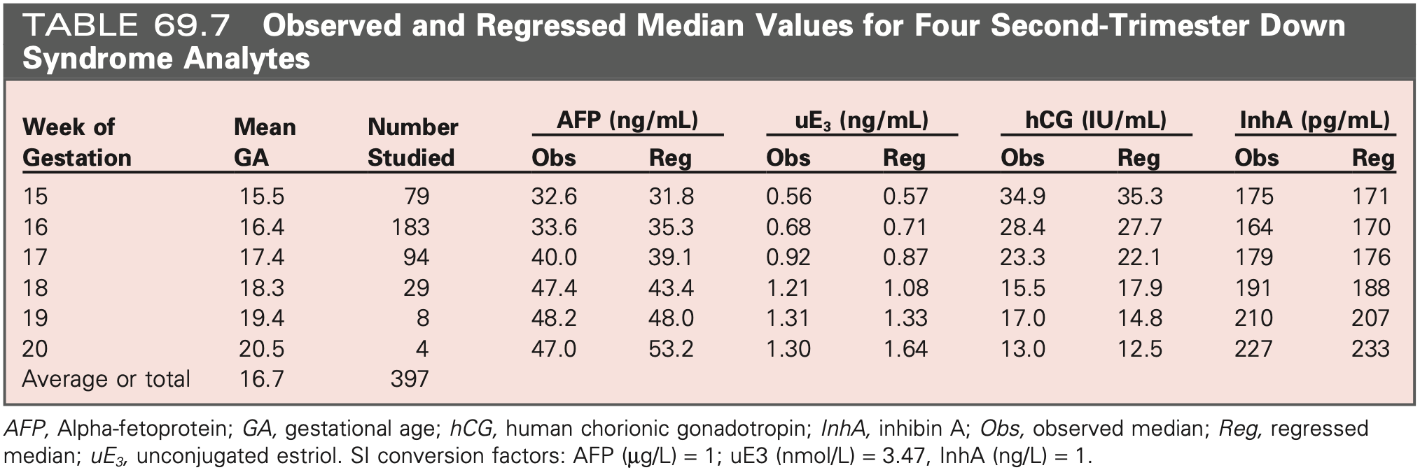
If first time to establish median value - 1st alternative
Obtain measurements on 300 to 500 patient specimens
Derive median values for each week of gestation
To fit observed data, use weighted regression analysis

Slide 56
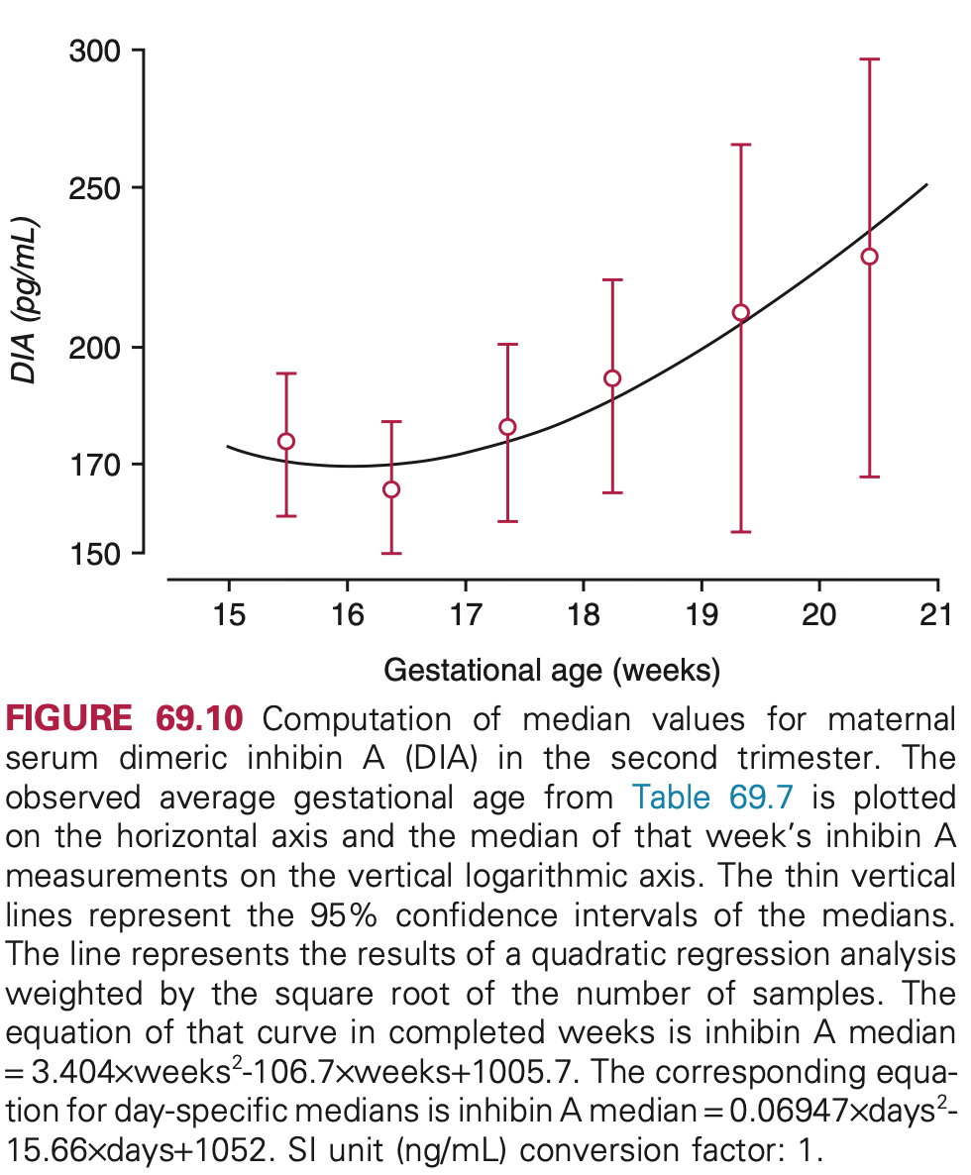
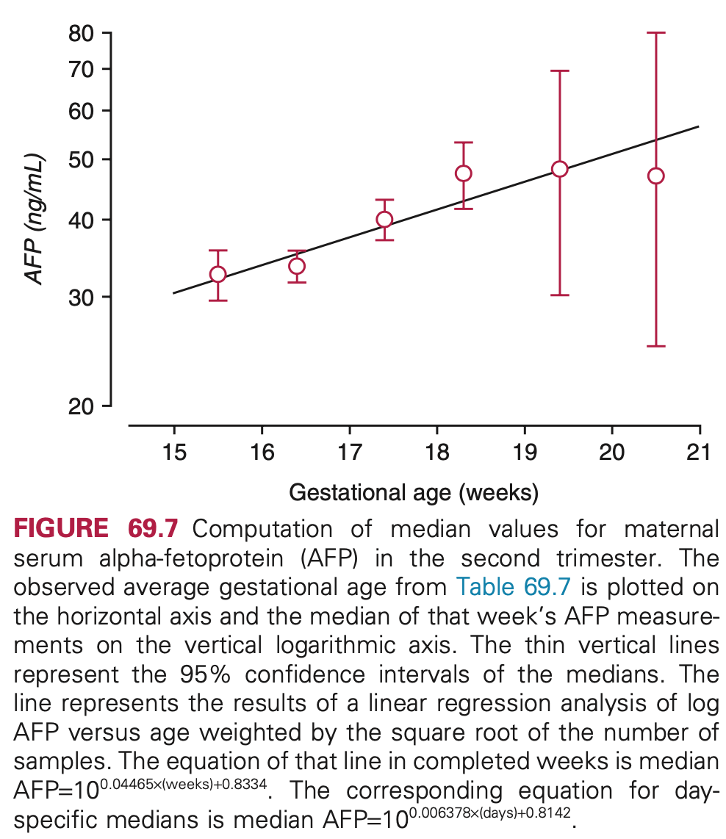

Slide 57
If first time to establish median value – 2nd alternative
Share reliable median values from other laboratory
Each Lab. measures 25~50 specimens
Compare using linear regression among Labs to establish relationship
Use regression equation to get sets of medians
Medians are used temporarily until 1st methods available

Slide 58
If update median values
Established by regression analysis
Using values of same patient specimens
Periodic adjustment
Select similar population
Check consistency of result
Notes:
Periodical monitoring?? 필요 시 추가하기

Slide 59
Epidemiologic Monitoring - NTD
Validate new median using IPR
If the IPR is within range, new median is appropriate
Continuous IPR monitoring
LOT change
Reagent deterioration
Poor technical performance

Slide 60
Epidemiologic Monitoring - NTD
If so, how large change in IPR is significance?
No one knows
Affecting factors: GA, and external factors…
Usually,
10% (or 7%) of changes in measured value
50% (or 25%) of changes in IPR
Need to be recalculated

Slide 61
Epidemiologic Monitoring – Down syndrome
IPR is influenced by each assay
Cannot figure out which assay is problematic with wrong IPR
Assay specific IPR monitoring
If significant change is observed
e.g.) elevated IPR, decrease of median MoM for uE3
If check QC material, followed by same result
New sets of median for uE3 need to be recalculated

Slide 62
Epidemiologic Monitoring – Down syndrome
Maintain 10% (or 7%) of 1.0 MoM
IPR for Down syndrome is 5%, generally
Affecting factors
Type of tests
Cutoffs
Maternal age distribution
Gestational age (LMP or by US)

Slide 63
Epidemiologic Monitoring – NT measurements
Performed at multiple locations, by many individuals
Similar situations such as
Different assay and reagent lot
Different Lab.
Uniform screening results
To ensure uniformity
Training and certification

Slide 64
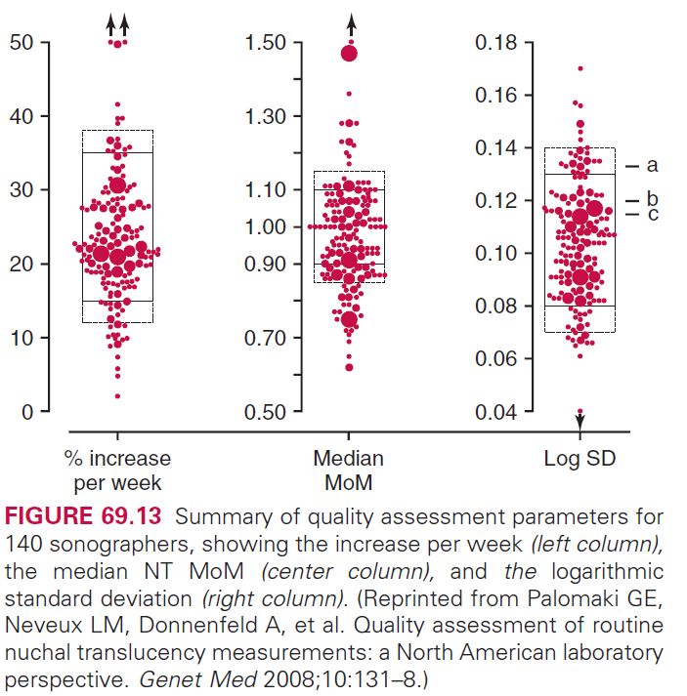
Epidemiologic Monitoring – NT measurements
Role of Labs.
Establish, monitor median NT data for each sonographers
By regression analysis
Should fit log-linear regression
Criteria
Normalized NT data should center at median of 1.0 MoM
SD of log MoM is within range of 0.1
Rate of increase is 25%, each week (10th~13th week)

Slide 65
Test | NTD | T21 | T18 | Trimester
AFP Only | ✔ |  |  | 2
Combined |  | ✔ | ✔ | 1
Triple | ✔ | ✔ | ✔ | 2
Quad | ✔ | ✔ | ✔ | 2
Integrated | ✔ | ✔ | ✔ | 1 & 2
Serum Integrated | ✔ | ✔ | ✔ | 1 & 2
Sequential | ✔ | ✔ | ✔ | 1 & 2
Laboratory Tests
Test | AFP | hCG | uE3 | Inhibin A | PAPP-A | NT | Trimester
Combined |  | ✔ |  |  | ✔ | ✔ | 1
Triple | ✔ | ✔ | ✔ |  |  |  | 2
Quad | ✔ | ✔ | ✔ | ✔ |  |  | 2
Integrated |  |  |  |  | ✔ | ✔ | 1
 | ✔ | ✔ | ✔ | ✔ |  |  | 2
Serum Integrated |  |  |  |  | ✔ |  | 1
 | ✔ | ✔ | ✔ | ✔ |  |  | 2
Sequential |  | ✔ |  |  | ✔ | ✔ | 1
 | ✔ | ✔ | ✔ | ✔ |  |  | 2

Slide 66
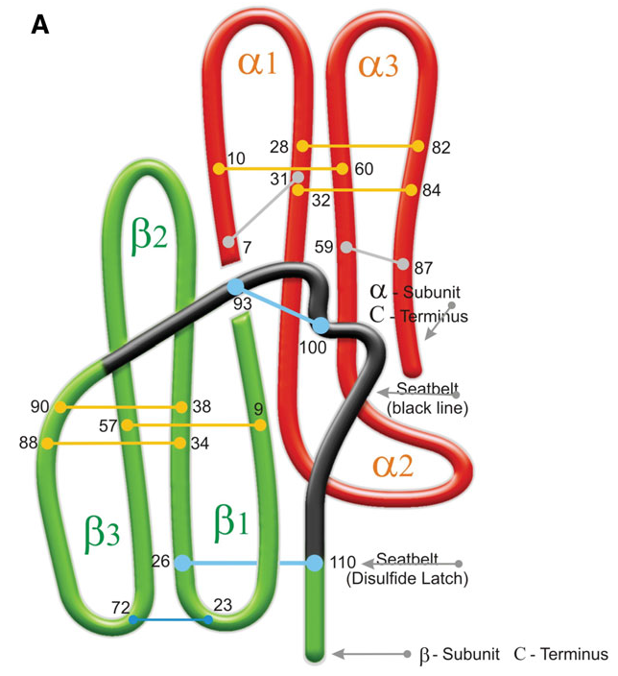
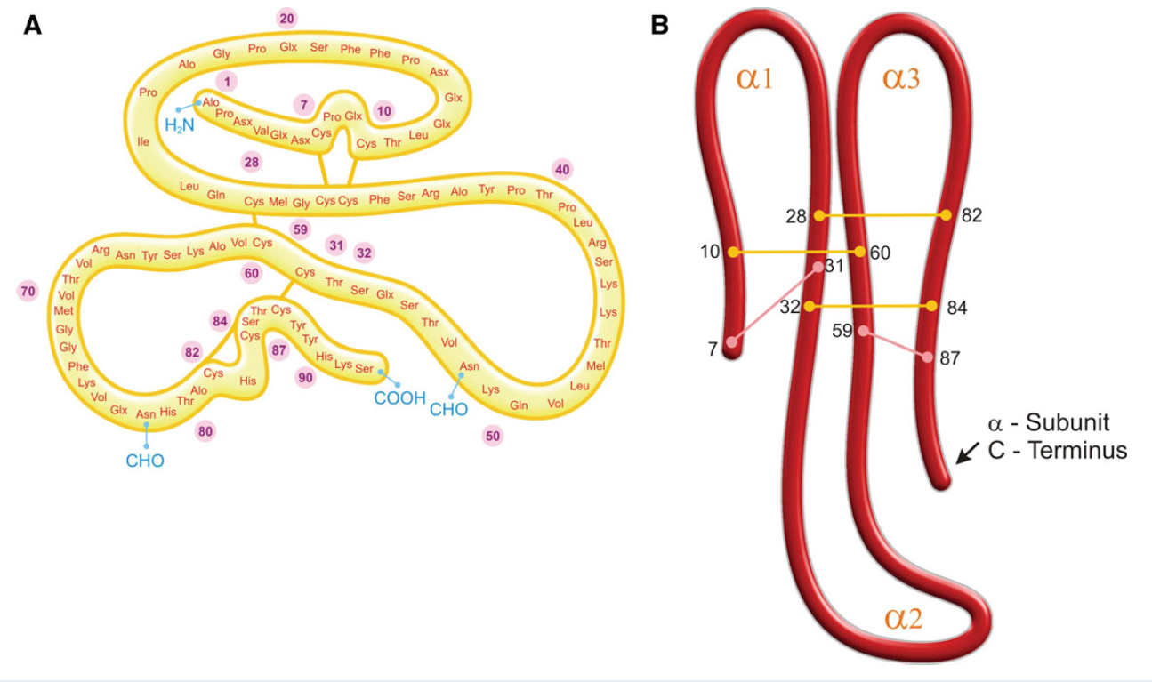
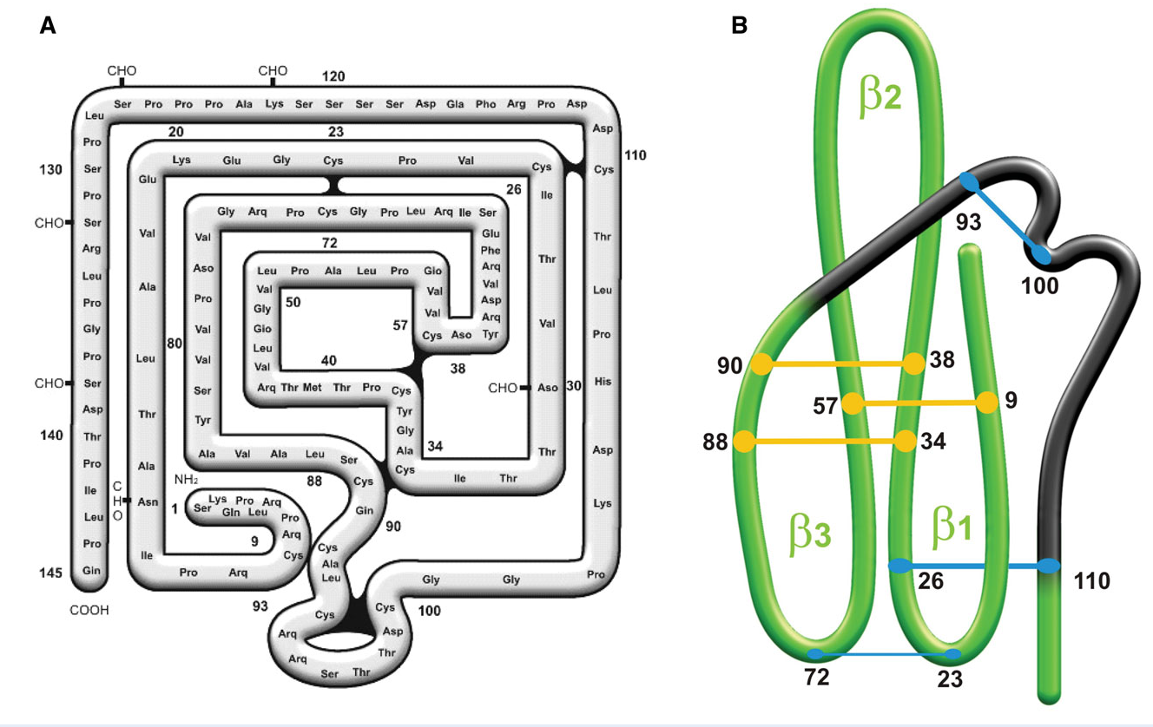
Lab. Tests – chronic gonadotropin
Purpose
Detect pregnancy (and ectopic, molar)
Down syndrome, trisomy 18
Follow-up for hCG producing cancer
Chemistry
Glycoprotein, protein core with carbohydrate side chains
αβ subunits
Dimeric active form
de Medeiros, S. F., & Norman, R. J. (2009). Human choriogonadotrophin protein core and sugar branches heterogeneity: basic and clinical insights. Human reproduction update, 15(1), 69–95. https://doi.org/10.1093/humupd/dmn036
Notes:
de Medeiros, S. F., & Norman, R. J. (2009). Human choriogonadotrophin protein core and sugar branches heterogeneity: basic and clinical insights. Human reproduction update, 15(1), 69–95. https://doi.org/10.1093/humupd/dmn036

Slide 67
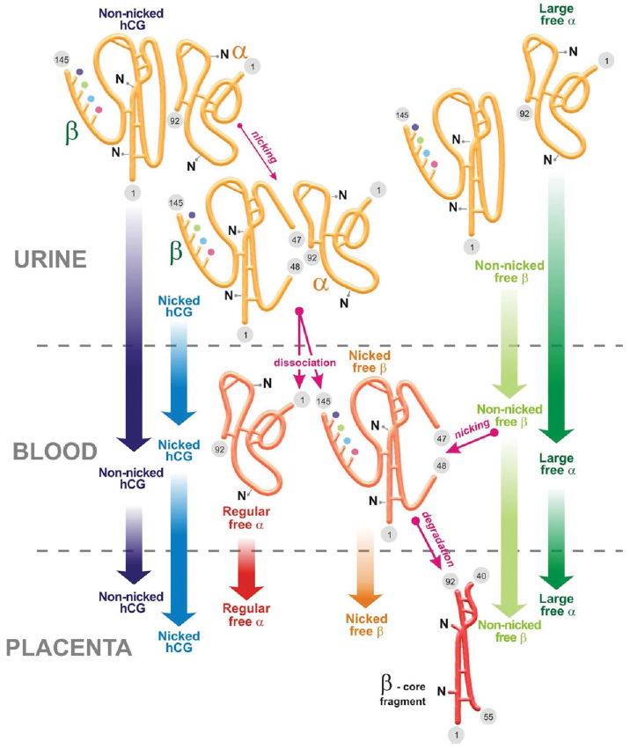
Lab. Tests – chronic gonadotropin
Composition
hCG-H(hyperglycosylated): decrease after 4th week
hCG: Predominant after 4th week
Types
hCGn (nicked hCG): nicking inactivates activity
hCGα (free α subunit)
hCGβ (free β subunit)
hCGβn (nicked hCGβ)
β core fragment
PLACENTA
URINE
de Medeiros, S. F., & Norman, R. J. (2009). Human choriogonadotrophin protein core and sugar branches heterogeneity: basic and clinical insights. Human reproduction update, 15(1), 69–95. https://doi.org/10.1093/humupd/dmn036
Notes:
de Medeiros, S. F., & Norman, R. J. (2009). Human choriogonadotrophin protein core and sugar branches heterogeneity: basic and clinical insights. Human reproduction update, 15(1), 69–95. https://doi.org/10.1093/humupd/dmn036

Slide 68
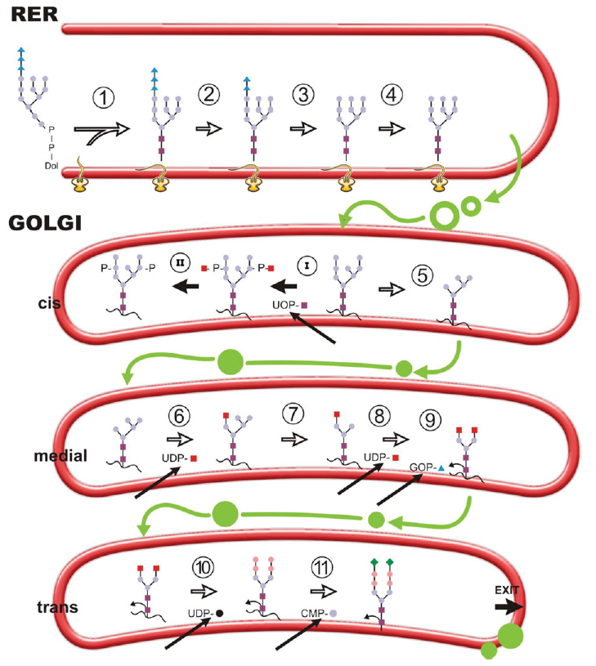
Lab. Tests – chronic gonadotropin
Biochemistry
Synctiotrophoblast, cytotrophoblast, hypopituitary
α in chr. 6, β in chr. 19
Subunits binding in rough ER
hCGβ is peak during 8~10th weak
hCGα increases with placental mass
Homology between LHβ and hCGβ
114 of 134 residues are same with LHβ
de Medeiros, S. F., & Norman, R. J. (2009). Human choriogonadotrophin protein core and sugar branches heterogeneity: basic and clinical insights. Human reproduction update, 15(1), 69–95. https://doi.org/10.1093/humupd/dmn036
Notes:
de Medeiros, S. F., & Norman, R. J. (2009). Human choriogonadotrophin protein core and sugar branches heterogeneity: basic and clinical insights. Human reproduction update, 15(1), 69–95. https://doi.org/10.1093/humupd/dmn036

Slide 69
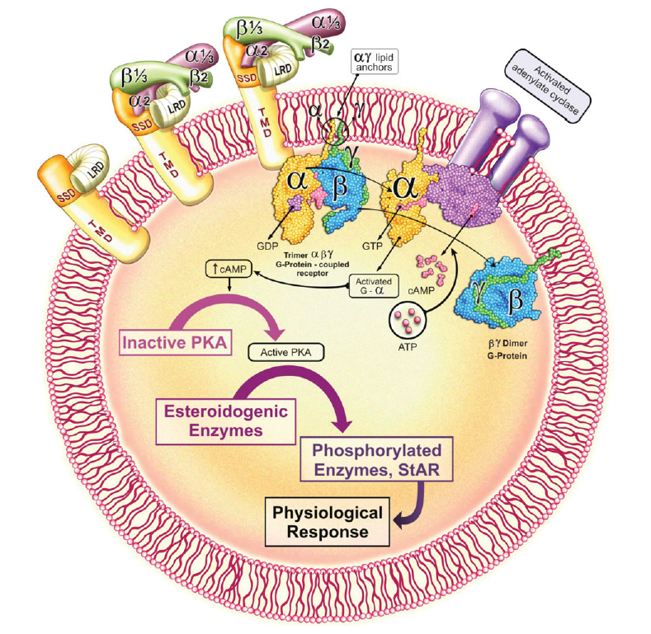
Lab. Tests – chronic gonadotropin
Physiology
hCG stimulates corpus luteum to make progesterone
Receptors are unknown
Glycation of α subunit trigger signal transduction
Elevated cAMP
Eventually progesterone is made
de Medeiros, S. F., & Norman, R. J. (2009). Human choriogonadotrophin protein core and sugar branches heterogeneity: basic and clinical insights. Human reproduction update, 15(1), 69–95. https://doi.org/10.1093/humupd/dmn036
Notes:
de Medeiros, S. F., & Norman, R. J. (2009). Human choriogonadotrophin protein core and sugar branches heterogeneity: basic and clinical insights. Human reproduction update, 15(1), 69–95. https://doi.org/10.1093/humupd/dmn036

Slide 70
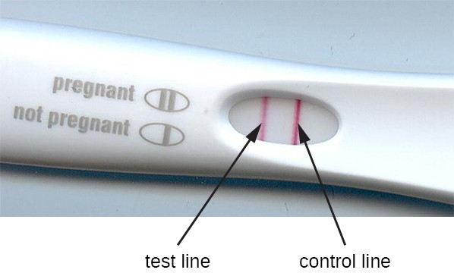
Lab. Tests – chronic gonadotropin
Assays
Initially, discriminating residue in hCGβ and polyclonal ab. was used
Qualitative hCG Tests
Immunochromatography
Quantitative hCG Tests
Different methods use different antibody -> makes complex
Standard material also contains hCGn, hCGβ
Not harmonized
https://courses.lumenlearning.com/microbiology/chapter/eias-and-elisas/
Notes:
https://courses.lumenlearning.com/microbiology/chapter/eias-and-elisas/

Slide 71
Lab. Tests – chronic gonadotropin
Specimen collection & handling
Standard phlebotomy
Fasting or non-fasting
Clot in RT then centrifuge to get serum
Stable in serum
Stored at 4~8℃,
Long-term storage (>weeks) -20~-70℃

Slide 72
Lab. Tests – chronic gonadotropin
Clinical aspects
hCG test helps
Diagnosing pregnancy and dating
Identifying ectopic/other abnormalities
Managing neoplasms
Predicting risk of T21 & T18

Slide 73
Lab. Tests – AFP
Purpose
Detecting fetal anomalies
Monitoring cancers
Chemistry
Glycoprotein (70,000 Da)
Single polypeptide chain
Carbohydrate composition is meaningless in pregnancy

Slide 74
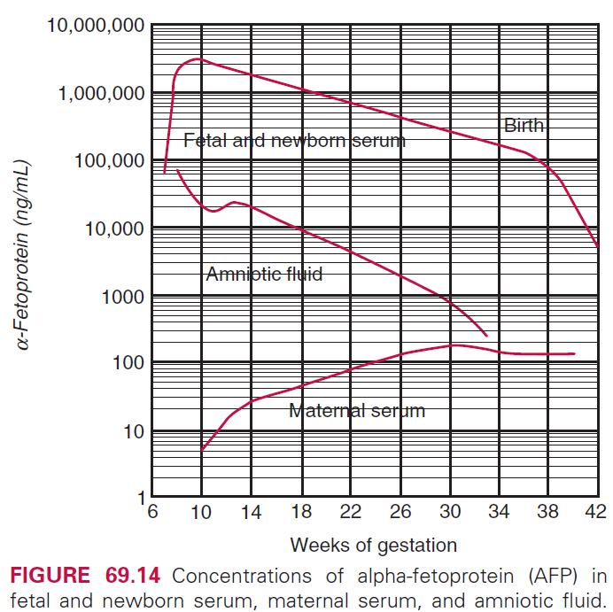
Lab. Tests – AFP
Biochemistry
4q11-22
Synthesis: Yolk sac (initial) – fetal liver
Peak at 9th week then decrease (fetal serum)
Detect from 10th week, ↑15%/week until 25th
Factors affect maternal serum conc.
Fetal-maternal transfer
Rapid growth of fetus and relatively constant size of mother
Maternal clearance of protein
Variation of volume distribution with maternal weight

Slide 75
Lab. Tests – AFP
Assays
Radioimmunoassay: obsoleted
Immunoenzymometric assay
Chemiluminescent immunoassay
Calibration
Two standard materials: WHO, British standard
Usually reported in mg/L (ng/mL)
1.21ng = 1 IU
Lower detection limits
Increased precision
Speed
Radioactivity
Automation

Slide 76
Lab. Tests – AFP
Specimen collection & handling
Standard phlebotomy
Non-fasting
Stable in serum
Stored at 4~8℃ until a week,
Long-term storage (years) -20℃

Slide 77
Lab. Tests – AFP
Clinical aspects
Increase in 85~95% of open NTD
Decrease in 30% of fetal Down syndrome
Not required for healthy pregnancy

Slide 78
Lab. Tests – AFP
Measure AFP in amniotic fluid
Same methods for maternal serum
Less stable
Make aliquot and keep refrigerated
False elevation when contaminated with fetal blood
Measure AChE in amniotic fluid
Confirmatory test
Normally present only in CSF

Slide 79
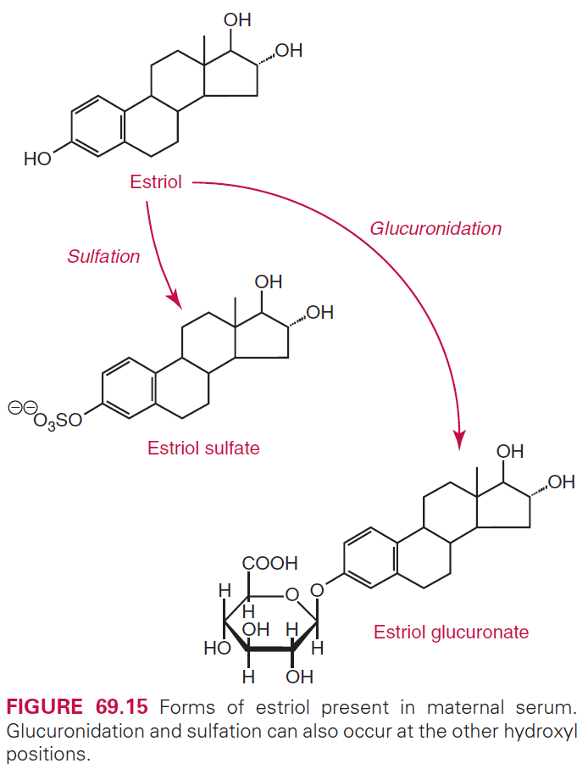
Lab. Tests – uE3
Purpose
Screening for Down syndrome
Chemistry
Estriol is estrogen
Trace in non-pregnant
Predominant during late pregnancy
Unconjugated fraction is 10%
Binding with sex hormone-binding protein because of low solubility

Slide 80
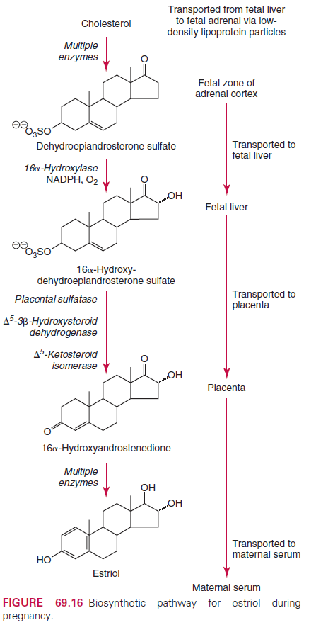
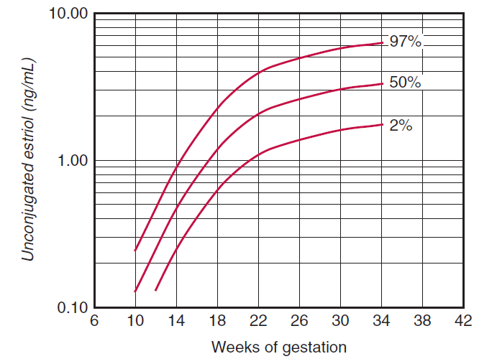
Lab. Tests – uE3
Biochemistry
Cholesterol is intake by fetal adrenal
Cholesterol → DHEA-S –(liver)→ 16α-OH-DHEAS
90% of maternal serum E3 originate from fetus
↑20~25% / week in 2nd trimester
Notes:
Falah N, Torday J, Quinney SK, Haas DM (2015). Estriol review: Clinical applications and potential biomedical importance. Clin Res Trials 1: doi: 10.15761/CRT.1000109
dehydroepiandrosterone sulfate (DHEA-S)

Slide 81
Lab. Tests – uE3
Assays
Radioimminoassay: obsoleted
Nonisotopic assays
uE3 is most variable of the screening analytes
Calibration
Chemically pure estriol
Usually reported in ng/mL, mg/L, nmol/L
1ng/mL = 3.47nmol/L
Notes:
Falah N, Torday J, Quinney SK, Haas DM (2015). Estriol review: Clinical applications and potential biomedical importance. Clin Res Trials 1: doi: 10.15761/CRT.1000109
dehydroepiandrosterone sulfate (DHEA-S)

Slide 82
Lab. Tests – uE3
Specimen collection & handling
Standard phlebotomy
Non-fasting
Most unstable of the screening analytes
Separate serum immediately
Stored at RT, 4℃ until a week (unpublished data),
uE3 increased stored ≥ 4 days at RT

Slide 83
Lab. Tests – uE3
Clinical aspects
Decrease of maternal uE3 due to biosynthetic pathway problem
Fetal anencephaly
Placental sulfatase deficiency
Fetal death
Chromosome abnormalities
Molar pregnancy
Smith-Lemil-Optiz syndrome
Delayed labor and higher C-sec rate because of low uE3

Slide 84
Lab. Tests – inhibin A
TGFβ superfamily protein
Inhibin A & B is active form
Chemistry
αβ Dimer, protein
2 types of β subunit: β_{A}, β_{B}
2 types of inhibin: inhibin A(αβ_{A}), inhibin B(αβ_{B})
Activin(β subunit only), activin/Inhibin dimer: not well known
Inhibin A is the only screening inhibin

Slide 85
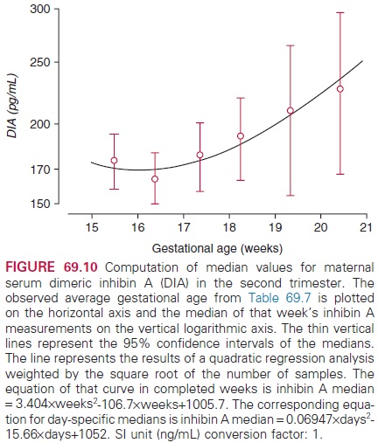
Lab. Tests – inhibin A
Biochemistry
Suppress FSH secretion
Synthesized at placenta, granulosa cell of oocyte, Sertoli cell of testis
Peak during 8~10th week
Nadir at 17th week, then increase slightly
Relative flat during 15~20th week
Typical value of 17th week: 175 ng/L

Slide 86
Lab. Tests – inhibin A
Assays
ELISA, RIA for against all inhibin type (obsoleted)
Currently, only dimeric inhibin A is measured by monoclonal ab.
Specimen collection & handling
Standard phlebotomy
Non-fasting
Stored at 4-8℃ until a week

Slide 87
Lab. Tests – inhibin A
Clinical aspects
Down syndrome
Ovarian cancer marker
Male infertility

Slide 88
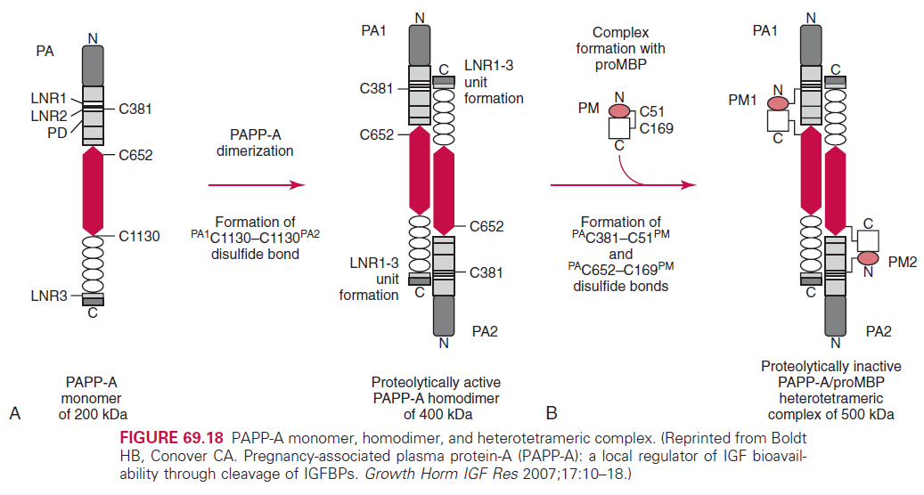
Lab. Tests – PAPP-A
Unique serum marker for Down syndrome
Low in 1st trimester (0.34 MoM), normal in 2nd (1.11 MoM)
Chemistry
Located in chr. 9, 22 exons, 1626(1546 in mature form) AAs
Heterotetramer
2 PAPP-A + 2 proMBP

Slide 89
Lab. Tests – PAPP-A
Biochemistry
Zinc contain metalloproteinase glycoprotein
Express in all tissues with low conc.
High PAPP-A & mRNA in placental tissue during pregnancy
Maternal serum PAPP-A is increased from conception to term
Act as IGFBP protease
Important to normal fetal growth

Slide 90
Lab. Tests – PAPP-A
Assays
ELISA: obsoleted
Significant between-method differences
Ongoing standardization

Slide 91
Lab. Tests – PAPP-A
Specimen collection & handling
Standard phlebotomy
Non-fasting
Concentration is increased in plastic tube than glass
Decrease in EDTA, heparin tube (Zn-chelating by EDTA, Heparin masks epitope)
Stable during 9 freeze-thaw cycles
Stable at 4℃ more than a week

Slide 92
Lab. Tests – PAPP-A
Clinical aspects
Low PAPP-A in 1st trimester
Down syndrome
High rate of fetal loss
IUGR
Premature delivery
Hypertension
Preeclampasia
Low PAPP-A in 2nd trimester: Cornelia de Lange syndrome (case)

Slide 93
Lab. Tests – fFN
Fetal fibronectin
To predict preterm delivery
Concentration in cervical and vaginal secretions is measured
Negative results show an 1% chance of delivering in a week
Low PPV

Slide 94
Lab. Tests – PAMG-1
Placental α-macroglobulin-1
To detect PROM
High amount in amniotic fluid (2000~25000 ng/mL)
Low amount in
Maternal blood (5-25 ng/mL)
Cervicovaginal fluid with intact membrane (0.05~2 ng/mL)
Rapid immunochromatography
More sensitive than nitrazine, ferning test

Slide 95
Tests for Evaluation Fetal Lung Maturity
Help to assess the risk of RDS (respiratory distress syndrome)
Common situations need tests are
Preterm labor
PROM
Worsening maternal hypertension
Severe renal disease
IUGR
Fetal distress

Slide 96
Tests for Evaluation Fetal Lung Maturity
Not recommended for (ACOG)
Delivery before 32nd weeks
Mandated delivery due to fetal or maternal indication
Indicated for (ACOG)
Scheduled delivery before 39th week, if FLM can’t be inferred from clinical history
Analyte is amniotic fluid
Obtained by transabdominal amniocentesis

Slide 97
Tests for Evaluation Fetal Lung Maturity
Available Tests
Lamellar body count (LBC)
Measuring phosphatidylglycerol
Lecithin/Sphingomyelin ratio

Slide 98
FLM – Lamellar body counts
By Automated CBC counter
Because of similarity in size between lamellar bodies, platelets
95~100% sensitivity
~70% specificity

Slide 99
FLM – L/S ratio
Lecithin
Major lung surfactant
Increase throughout 3rd trimester
Sphingomyelin
Sources are other than the lung
Relatively constant concentration
Used as an internal standard
L/S ratio: tends to rise with increasing GA

Slide 100
FLM – Phosphatidylglycerol
Present exclusively in the lung
Rapid agglutination test using anti-phosphatidylglycerol ab.
Positive means normal and 99% predictive of maturity
But, only 25% of negative develop RDS
Useful for contaminated specimen with blood or meconium

Slide 101
Literatures
O'Brien, J. E., Dvorin, E., Drugan, A., Johnson, M. P., Yaron, Y., & Evans, M. I. (1997). Race-ethnicity-specific variation in multiple-marker biochemical screening: alpha-fetoprotein, hCG, and estriol. Obstetrics and gynecology, 89(3), 355–358. https://doi.org/10.1016/S0029-7844(96)00524-8

Slide 102
Pregnancy and Its Disorders
Chapter 59
2020. 6. 12.

